Slide 1

SkillMates
BY TEAM: TECHNO-TITANS
Teammates:
Pramodh Gompa
Pranay Reddy
Aakash Shaw
Soham Targude
Presenter name

Slide 2

Introduction To the Website
Skillmates aims to promote learning, collaboration, and skill-sharing among students at VIT University.
The program provides a platform for students to connect with each other, exchange knowledge and skills, and build professional relationships on campus.
Skillmates is an excellent opportunity for students to enhance their learning experience, gain practical experience in their areas of interest, and expand their network.

Slide 3
Tech Stack
Front-end Development :
HTML: Hypertext Markup Language provides the structure and content of the web pages.
CSS: Cascading Style Sheets is used for styling and presentation, controlling the layout, colors, fonts, and other visual aspects of the website.
JavaScript: A programming language that enables interactivity and dynamic functionality on the client-side of the web application.
Back-end Development :
Programming Language you can choose from several languages such as:
JavaScript: With Node.js, you can use JavaScript for both front-end and back-end development.

Slide 4
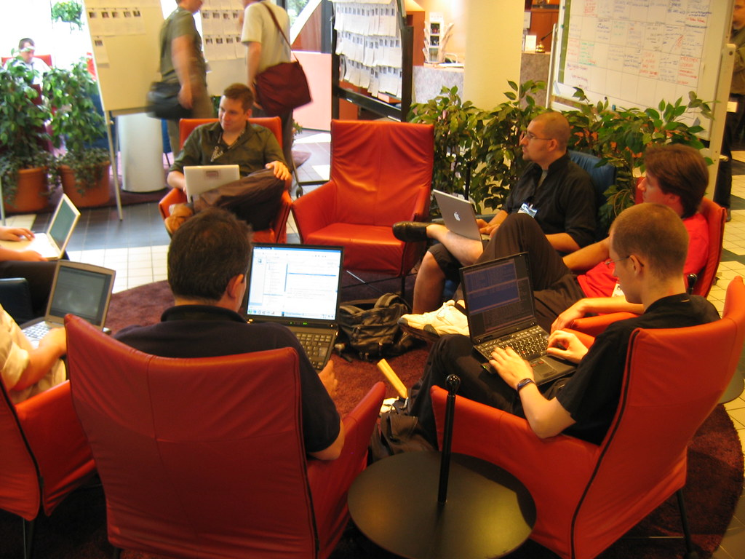
Topic one
PURPOSE
To provide a platform where students can exchange skills with each other.
To promote learning, collaboration, and skill-sharing among students.
To help students gain practical experience in their areas of interest.
To encourage networking and building professional relationships among students.
To encourage the sharing of resources and knowledge on campus.
Subtitle
This Photo by Unknown Author is licensed under CC BY

Slide 5

Why it is Needed?
Many students want to gain practical experience in their areas of interest but don't have access to resources or mentorship
Collaborating with others on projects and assignments can enhance the learning experience and promote teamwork
The website can help build a community of students who share similar interests and passions
Walt Disney

Slide 6

How it Works
First you have to visit our website.
Create a profile with your name, photo, and a brief description of yourself.
List your skills and areas of expertise.
Search for other students who can teach you the skills you want to learn.
Communicate with them through the website to schedule sessions and track your progress.

Slide 7
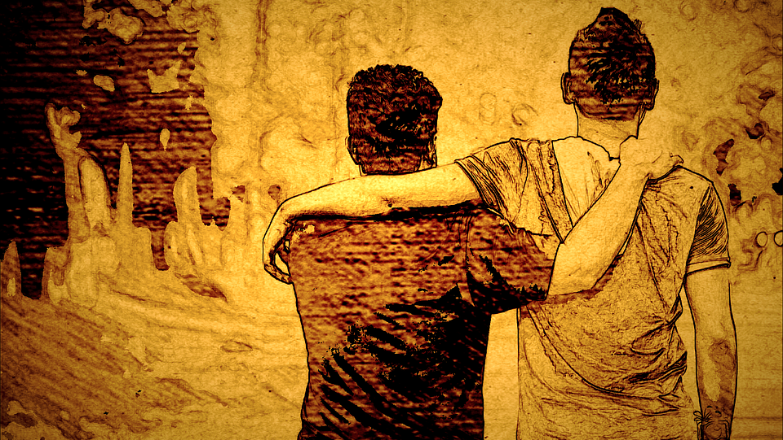
Conclusion
It is a community-driven program that promotes learning and development among students at VIT University.
Students can expand their network, and enhance their overall learning experience.
This program is an excellent opportunity for students to bridge the gap between theory and practice and prepare themselves for a successful career.

Slide 8

THANK YOU

